Slide 1


Faculty of Information Engineering, Computer Science and Statistics, Sapienza University of Rome Master’s degree in Engineering in Computer Science Academic Year 2020-2021
Cyber Risk Management for Dummies
The Hitchhiker’s Guide to Critical Infrastructures
Candidate: Edoardo Puglisi
Thesis Advisor: Silvia Bonomi
Notes:
The title of my thesis is “Cyber risk management for dummies” so that everyone should feel comfortable about what im going to explain.

Slide 2




WE LIVE IN A SOCIETY…
Notes:
Our society is composed by different kinds of business, from small and medium enterprises to critical infrastructures. As the name suggest, critical infrastructures are a bit more important than others because from them depends the proper functioning of the society but all of them have one thing in common…

Slide 3

Notes:
Everything now relies on Information and Communication Technologies, in other words cyberspace.
On the one hand we have benefits like automation of boring processes, on the other hand we have the huge amount of risks coming from what its called fifth domain.

Slide 4
RISK
“Effect of uncertainty on objectives”
Something bad that may happen
Notes:
One definition of risk is “Effect of uncertainty on objectives”, practically speaking “the possibility that something bad may happen”. What is considered bad depends from case to case.

Slide 5

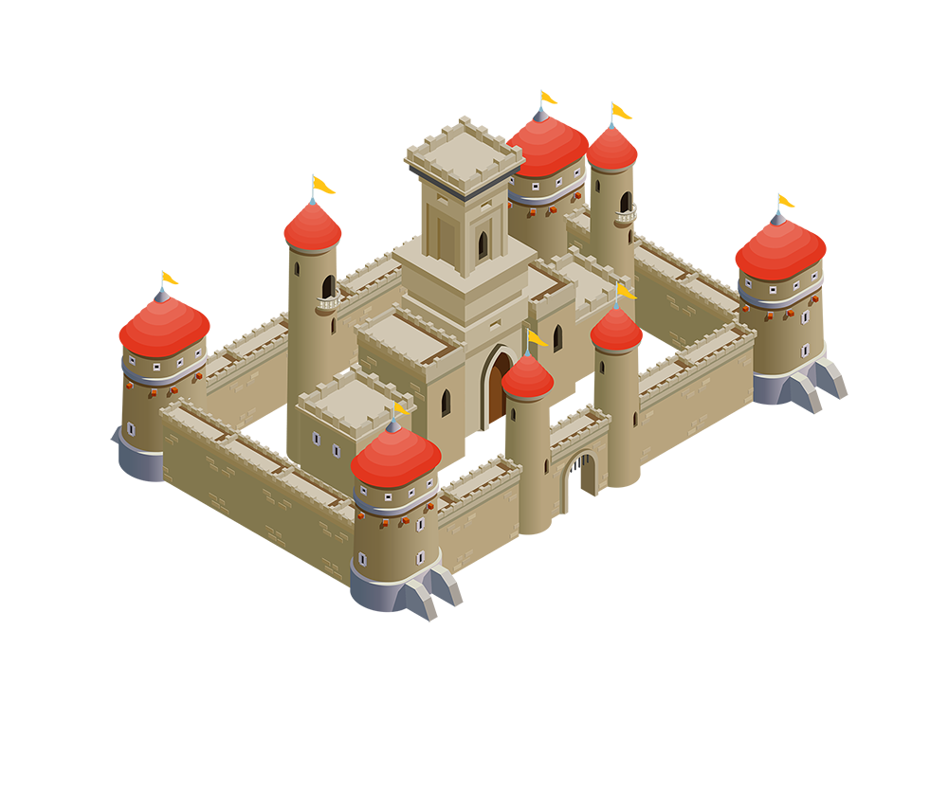

RISK THEN…
Maybe next time..
Notes:
During the middle age, for example, one risk was to be invaded by enemy. To fix this problem, they had the good idea to build walls around the city or at least around the castle to protect what was important for them: their lifes.

Slide 6


RISK NOW
Notes:
The situation nowadays is similar.
The castles we have to protect are the organizations relying on cyberspace, in particular the critical infrastructures that now depend on it.
The attackers are no more armies of knights but people specialized in Information and Communication Technologies aiming to stop processes or steal sensitive data.
The solution we have is what we call Cyber Risk Management

Slide 7
CYBER RISK MANAGEMENT
Set of procedures that aims to assess what are the possible risks, how to avoid them or how to fix the damage.
Risk Analysis Methodologies
Cyber Security Frameworks
Notes:
What is Cyber Risk Management? Its the set of security procedures with the goal of protecting the organizations from risk, avoiding them or fixing the damage they caused.
CRM makes use of two main kind of procedures: Risk Analysis Methodologies and Cyber Security Frameworks

Slide 8
CYBER RISK MANAGEMENT
METHODOLOGY
Systematic process for assessing the likelihood of risks and their impact in order to understand their nature and find source and possible solutions.
FRAMEWORK
The “lifestyle” of the organization. Structured model that brings cybersecurity and information security within all levels inside an organization.
Notes:
Methodologies are systematic processes that assess the likelihood of risks and their impact on the target organization. The goal is to understand the causes and then the possible solutions
Frameworks instead are something like the lifestyle of the organization. Frameworks want to implement cybersecurity and information security by design at all levels inside the organization.

Slide 9
CYBER RISK MANAGEMENT
WHERE?
WHAT?
WHO?
HOW?
THEN?
Context
Organization position in the business sector, its objectives and what it wants to protect.
Notes:
CRM process is straightforward.
1. Understand where we are in the business sectors, our goals and what we want to protect.

Slide 10
CYBER RISK MANAGEMENT
WHERE?
WHAT?
WHO?
HOW?
THEN?
Risks
Assess the possible risks the organization may face
Notes:
2. Assess what may happen to the assets we want to protects
For example data breaches or denial of service attacks

Slide 11
CYBER RISK MANAGEMENT
WHERE?
WHAT?
WHO?
HOW?
THEN?
Attackers
Understand who may be the responsible for the attack and his motivations
Notes:
3. Who are the attackers and why they want to attack us? Knowing their skill will help to determine their impact on the organization.

Slide 12
CYBER RISK MANAGEMENT
WHERE?
WHAT?
WHO?
HOW?
THEN?
Vulnerabilities
Find out how the attack was carried out and which flaws were exploited.
Notes:
4. Which are the vulnerabilities they may exploit and how they would exploit them.

Slide 13
CYBER RISK MANAGEMENT
WHERE?
WHAT?
WHO?
HOW?
THEN?
Solutions
Evaluate all previous steps and find a solution before it’s too late.
Notes:
Last step is to evaluate all previous steps in order to have a general overview of the situation and then find possible solutions.

Slide 14
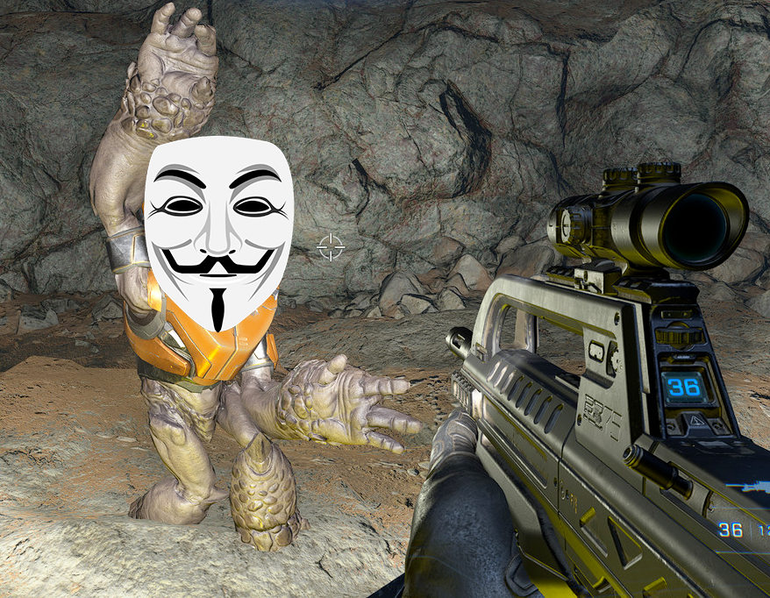
CYBER RISK MANAGEMENT
Notes:
Shot the attackers is not a solution and the ones we have may be more complex than you think.

Slide 15


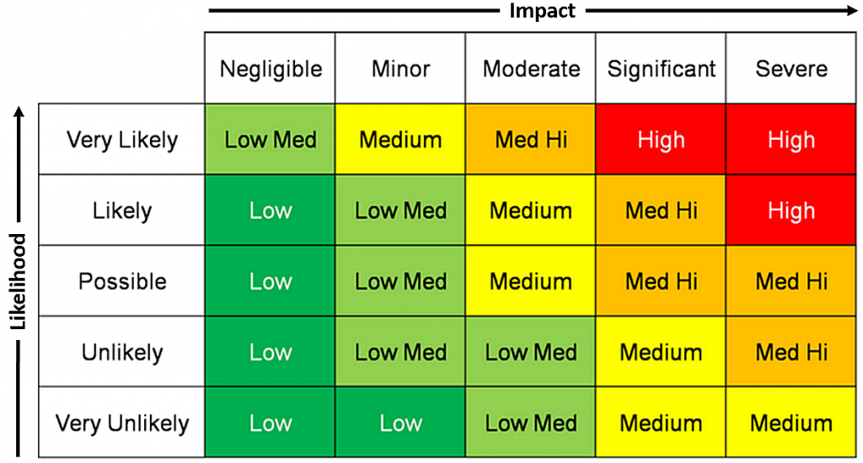

ON THE OTHER HAND…
Too much choice of tools
Confusing security procedures
Processes too complex for small organizations
According to IBM Cybersecurity Intelligence Index Report:
95% of cyber security breaches are primarily caused by human error
In particular within Healthcare Infrastructure
VS
The Dumb Employee
Notes:
If well-structured organizations manage to implement these solutions without problems, it is not the same for smaller entities or those who are not experts in the field of cybersecurity.
The tools available are many and often complex.
Security procedures are confusing.
Organizations, especially small ones, don't know where to start when approaching cybersecurity.
From the data regarding cyber attacks in recent years the main source of attack is to be attributed to human error.
This is due to the fact that all the proposed solutions are useless against untrained staff or people that are unaware of cybersecurity procedures.

Slide 16
MOTIVATION AND GOAL
Creation of an easy-to-access knowledge base about cyber risk management
FOR EVERYONE: Newbies or Professionals
Notes:
The goal of this survey is to create an easy-to-access knowledge base that can help anyone approaching cybersecurity for the first time. Being them newbies or professionals.
Keeping this in mind I analyzed different risk analysis methodologies and cybersecurity frameworks to evaluate them according to criteria that may be useful for a newcomer in this sector.

Slide 17







TUTORIAL FOR DUMMIES
ADAPTABLE
METHODOLOGY | PROS | CONS
MEHARI | Opensource Huge knowledge base | For professionals
OWASP | Opensource Easy to apply | High level analysis Not too much support on risk mitigation phase
EBIOS | Opensource In-depth analysis Face-to-Face meetings | Few automation Long process
SPECIALIZATION
SPECIFIC
FUNDAMENTAL CONCEPTS
COMPREHENSIVE
BREADTH OF COVERAGE
Notes:
The core part about my work was the comparison between the different risk analysis methodologies and cyber security frameworks.
I analyzed 3 of the most famous methodologies that aim to assess likelihood and impact of cyber risk. The dummy-level results about methodologies highlight that the main differences concern the automation and the depth of the assessment process. A newcomer to cyber risk management may prefer an easy to apply methodology like OWASP to a more complex but exhaustive one like EBIOS. Methodologies like MEHARI are left to professionals because its processes are a bit more complex and need higher level of skills.
In the same way I analized the cyber security frameworks available. Contrary to methodologies, frameworks are more structured set of processes that aim to implement cybersecurity within the organization.
As we can see the frameworks are a lot and this is not even the whole set and it may be difficult to choose between them. Knowing the level of adaptability, breadth of coverage and their own approach to cybersecurity and in some cases their cost will help the organization while choosing which framework suits best for it
Many frameworks are not specialized to a single sector and may be adapted to the organization needs.

Slide 18


ADAPTABLE
Notes:
Lets take an example.
Secure Control Framework is composed by a huge set of control and security procedures that can be implemented and adapted to any kind of organization while NIST CSF is focused mainly on critical infrastructures.
This doesn’t mean one is better than the other: in fact the huge amount of controls provided by SCF may be overwhelming for a small organization.
On the contrary NIST CSF has more structured and easy-to-follow approach and can be adopted even from organization with low cybersecurity skills.
Sometimes instead the differences are small and choosing between frameworks is just a matter of feelings. The target organization of NIST CSF and of National Cybersecurity Framework developed in collaboration with Sapienza University is almost the same. Knowing the peculiarity of each of frameworks is fundamental for a cyber risk manager in order to get the best out of each of them.

Slide 19
EASY-TO-FOLLOW
Notes:
Lets take an example.
Secure Control Framework is composed by a huge set of control and security procedures that can be implemented and adapted to any kind of organization while NIST CSF is focused mainly on critical infrastructures.
This doesn’t mean one is better than the other: in fact the huge amount of controls provided by SCF may be overwhelming for a small organization.
On the contrary NIST CSF has more structured and easy-to-follow approach and can be adopted even from organization with low cybersecurity skills.
Sometimes instead the differences are small and choosing between frameworks is just a matter of feelings. The target organization of NIST CSF and of National Cybersecurity Framework developed in collaboration with Sapienza University is almost the same. Knowing the peculiarity of each of frameworks is fundamental for a cyber risk manager in order to get the best out of each of them.

Slide 20
TARGET SPECIFIC
Notes:
Lets take an example.
Secure Control Framework is composed by a huge set of control and security procedures that can be implemented and adapted to any kind of organization while NIST CSF is focused mainly on critical infrastructures.
This doesn’t mean one is better than the other: in fact the huge amount of controls provided by SCF may be overwhelming for a small organization.
On the contrary NIST CSF has more structured and easy-to-follow approach and can be adopted even from organization with low cybersecurity skills.
Sometimes instead the differences are small and choosing between frameworks is just a matter of feelings. The target organization of NIST CSF and of National Cybersecurity Framework developed in collaboration with Sapienza University is almost the same. Knowing the peculiarity of each of frameworks is fundamental for a cyber risk manager in order to get the best out of each of them.

Slide 21



CONCLUSION
Creation of a guide “for dummies” that can be used by newbies and professionals as introduction to cyber risk management.
Analysis of cybersecurity posture inside critical infrastructures
Comparison between the different tools available to “Guardians of the Cyberspace”
Notes:
In conclusion, my work consisted in:
Creating a guide for every skill level as introduction to cyber risk management inside organizations dealing with cyber issues and for critical infrastructures.
analysing the current cybersecurity posture inside critical infrastructure. Highlighting the fact that human error is the main source of threats inside organizations.
Making a comparison between the main tools available to those whom I call “guardian of the cyberspace” or anybody that have to deal with cyberspace in general

Slide 22
Thanks for the attention

